Slide 1

Planetary Gear Reducer
Conceptual Design
Team 10
劉多聞 高子彧 林綠芸 葉蓁 何明耀

Slide 2
Outline
Conceptual Design
Load Condition
Engineering Drawing
Presentation

Slide 3
Outline
Conceptual Design
Load Condition
Engineering Drawing
Presentation

Slide 4
Design specifications confirmation
Reduction ratio = 15.6
Nominal transformed power
Power 32kW
Input 12000 rpm / 25 Nm
Output 770 rpm / 390 Nm
• Max speed condition
Input 20000 rpm / 15 Nm
Output 1300 rpm / 234 N

Slide 5
Conceptual design
The output speed needs to be reduced.
小齒輪(input)帶大齒(output)輪轉，因為大齒輪齒數高於小齒輪齒數，所以output轉速會 < input轉速
Sun gear : Input
Planet gears carrier : Output
Ring gear : Fixed

Slide 6
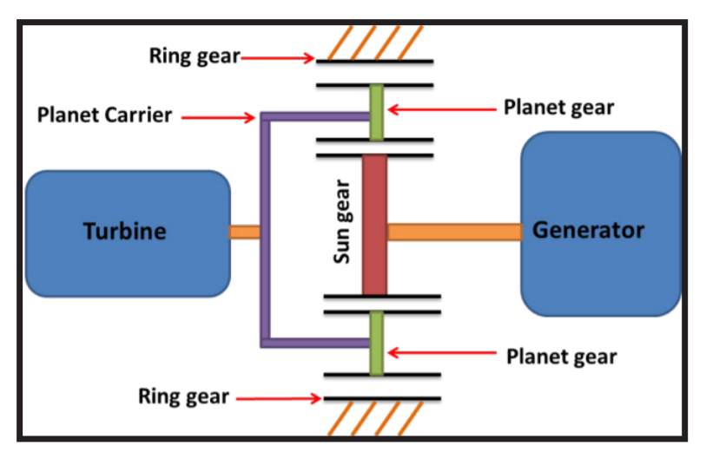
Conceptual design
(設計簡圖)
output
input

Slide 7
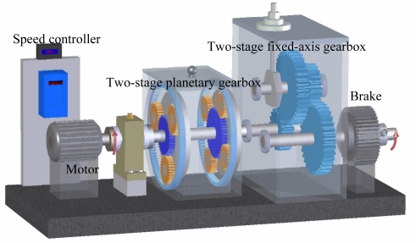
Conceptual design

Slide 8
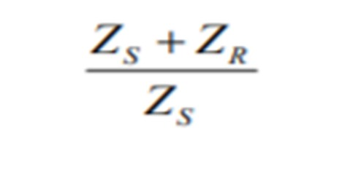
Conceptual design
By formula ： 齒輪直徑跟齒數成正比
Zcarrier = Zsun + (Zring – Zsun) / 2
We calculate from our reduction ratio : 15.6
Two stage reduction ratio : 3 * 5.2
Zring : Zsun : Zcarrier = 20 : 10 : 15(radius ratio)
Zring : Zsun : Zcarrier = 42 : 10 : 26(radius ratio)
模數、齒數、齒輪規格待定

Slide 9
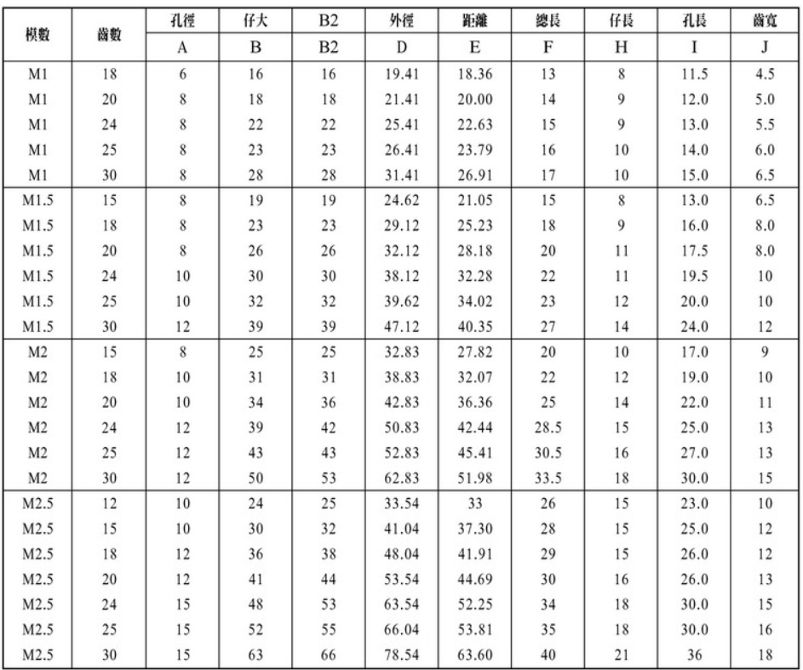
Conceptual design

Slide 10
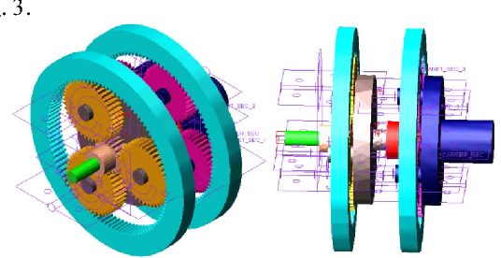
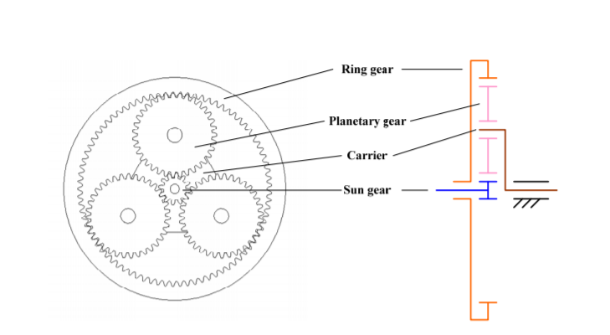
Simple schematics

Slide 11
Outline
Conceptual Design
Load Condition
Engineering Drawing
Presentation

Slide 12
Load Condition - spec
Power : 32KW
First Stage : Input :12000rpm/25Nm Output : 3333rpm/90Nm
Second Stage : Input : 3333rpm/90Nm Output : 770rpm/390Nm
First Stage Reduction Ratio : 3.6
Second Stage Reduction Ratio : 4.3
Total Reduction Ratio : 15.5
First Stage 齒數比 29: 22:73 半徑比 29:51:80
Second Stage 齒數比 19: 23:65 半徑比 19:42:65
Diameter < 180mm / Length < 120mm / Volume < 3L / Weight < kg

Slide 13
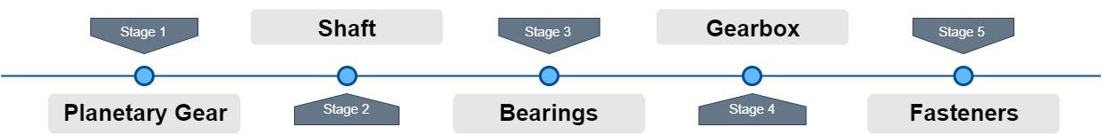
Load Condition - Design Flow

Slide 14
Load Condition - Design Flow

Slide 15
Gear
From General Planetary Gear combinations :
We choose these two configuration to meet our goal. (Reduction ratio ≈15.6)

Slide 16
Stage 1
Stage 1 | module | Teeth | Pitch diameter | bore diameter | pressure angle(degree) | Reduction Ratio
Ring | 1.5 | 73 | 109.5 |  | 20 | 3.6
Sun | 1.5 | 29 | 43.5 | 15 | 20
planet | 1.5 | 22 | 33 | 15 | 20
carrier |  |  | 76.5

Slide 17
Stage 2
Stage 2 | module | Teeth | Pitch diameter | bore diameter | pressure angle(degree) | Reduction Ratio
Ring | 1.5 | 65 | 97.5 |  | 20 | 4.3
Sun | 1.5 | 19 | 28.5 | 10 | 20
planet | 1.5 | 23 | 34.5 | 12 | 20 | Total ratio
carrier |  |  | 63 |  |  | 15.48

Slide 18
Gear – Why we choose these configuration
Co-prime to reduce wear.
The teeth ratios should be <3 to be feasible to work.
The difference of diameter size should not be to extreme to be robust to work effectively.

Slide 19
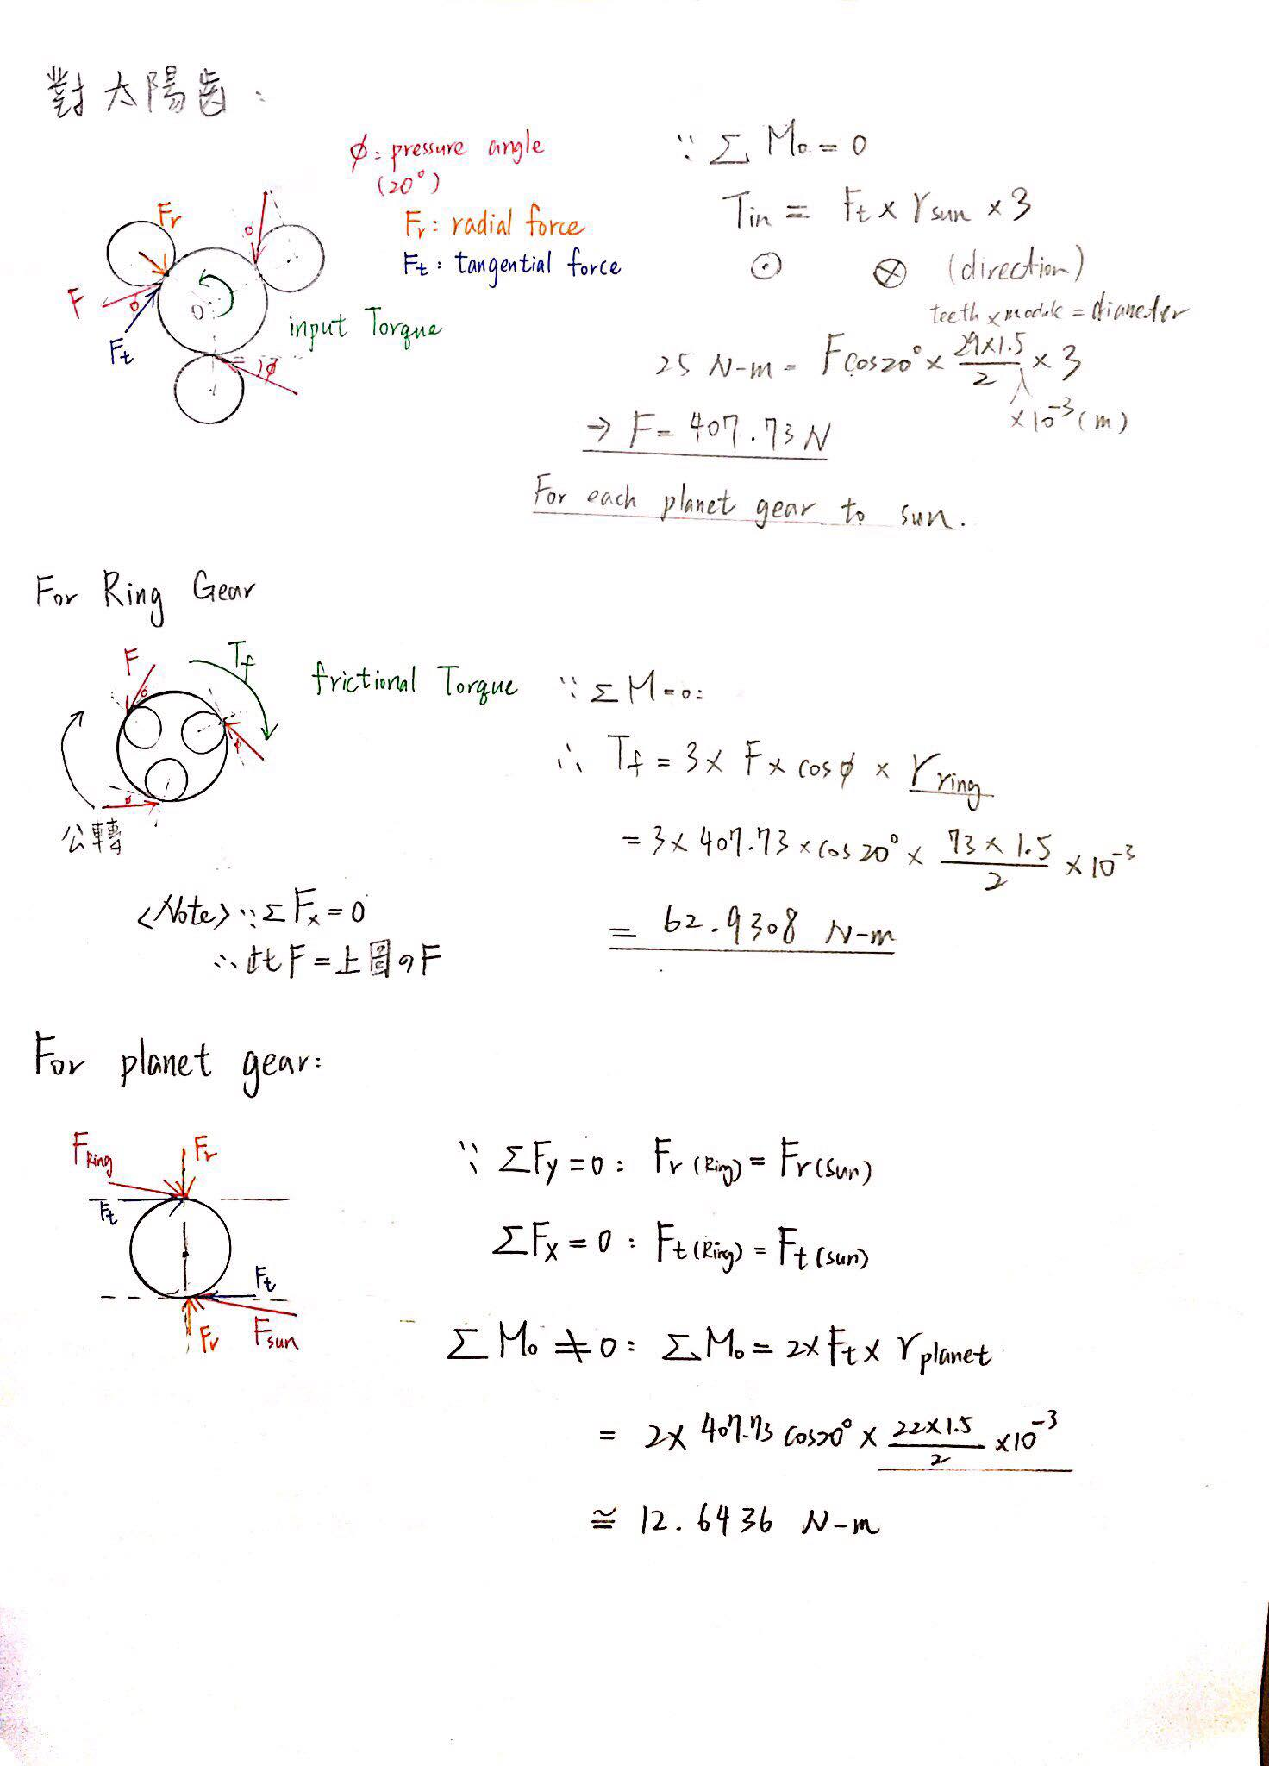
Gear – Load Analysis
Based on Input Torque 25 N-m :

Slide 20
Gear – Load Analysis
Based on Ring Gears are fixed :

Slide 21
Gear – Load Analysis
Based on force-equilibrium equations :

Slide 22
Gear – Load Analysis
Note : We assume that the sun gear is rotating at constant speed.
That is, we ignore the effect of angular acceleration.
But the net torque of each planet gear is not zero.
So they would have angular acceleration.

Slide 23
Load Condition - Design Flow

Slide 24
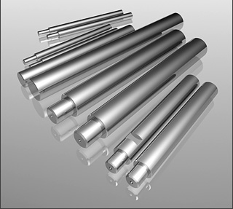
Shaft - Material
軸心：CRS (氣、油壓缸用活塞桿鍍鉻棒)
材質 : 中碳鋼 (S45C)
處理方式 : 研磨、表面鍍硬鉻、不生鏽。
型號：CRS15 / CRS12
外徑公差 f7：-16~-34 (µm)
重量：1.39(kg/m) / 0.89(kg/m)

Slide 25
Shaft – Why this shaft?
材質 : 中碳鋼 (S45C)
良好的強度與韌性
機械力學性能良好
Why choose it?
1. 高扭矩
2. 高徑向負載力

Slide 26
Shaft - Dimension
第x段 | 外徑 (mm) | 長度 (mm) | 重量 (1.39kg/m)
1 | 15 | 17(軸承)+5+5 | 3.753(g)
2 | 15 | 22 | 2.78(g)
3 | 15 | 17+5+5 (gear house外) | 3.753(g)
Connect with gear
第x段 | 外徑 (mm) | 長度 (mm) | 重量 (1.39kg/m)
1 | 12 | 10+12(軸承) | 3.336(g)
2 | 12 | 10+12 | 3.336(g)
Connect with carrier

Slide 27
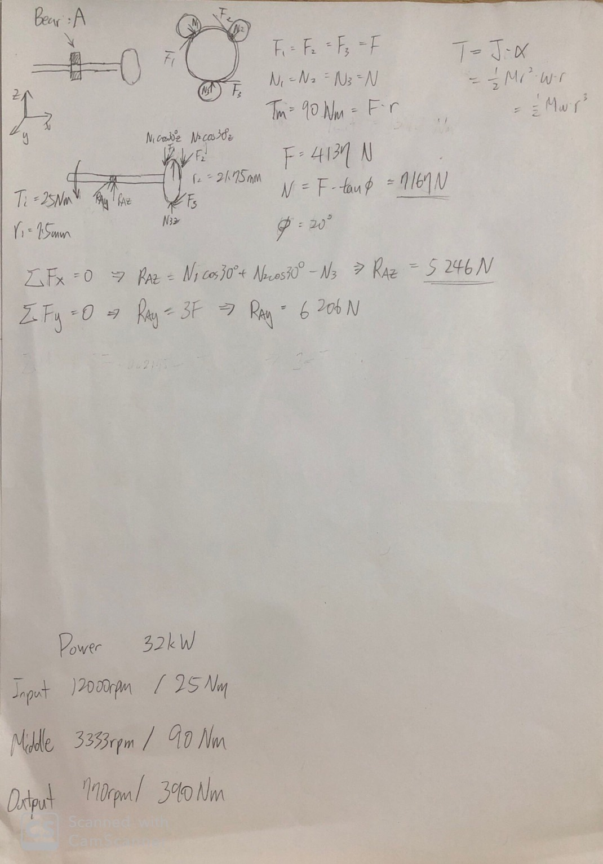
Shaft - Calculation
Draft

Slide 28
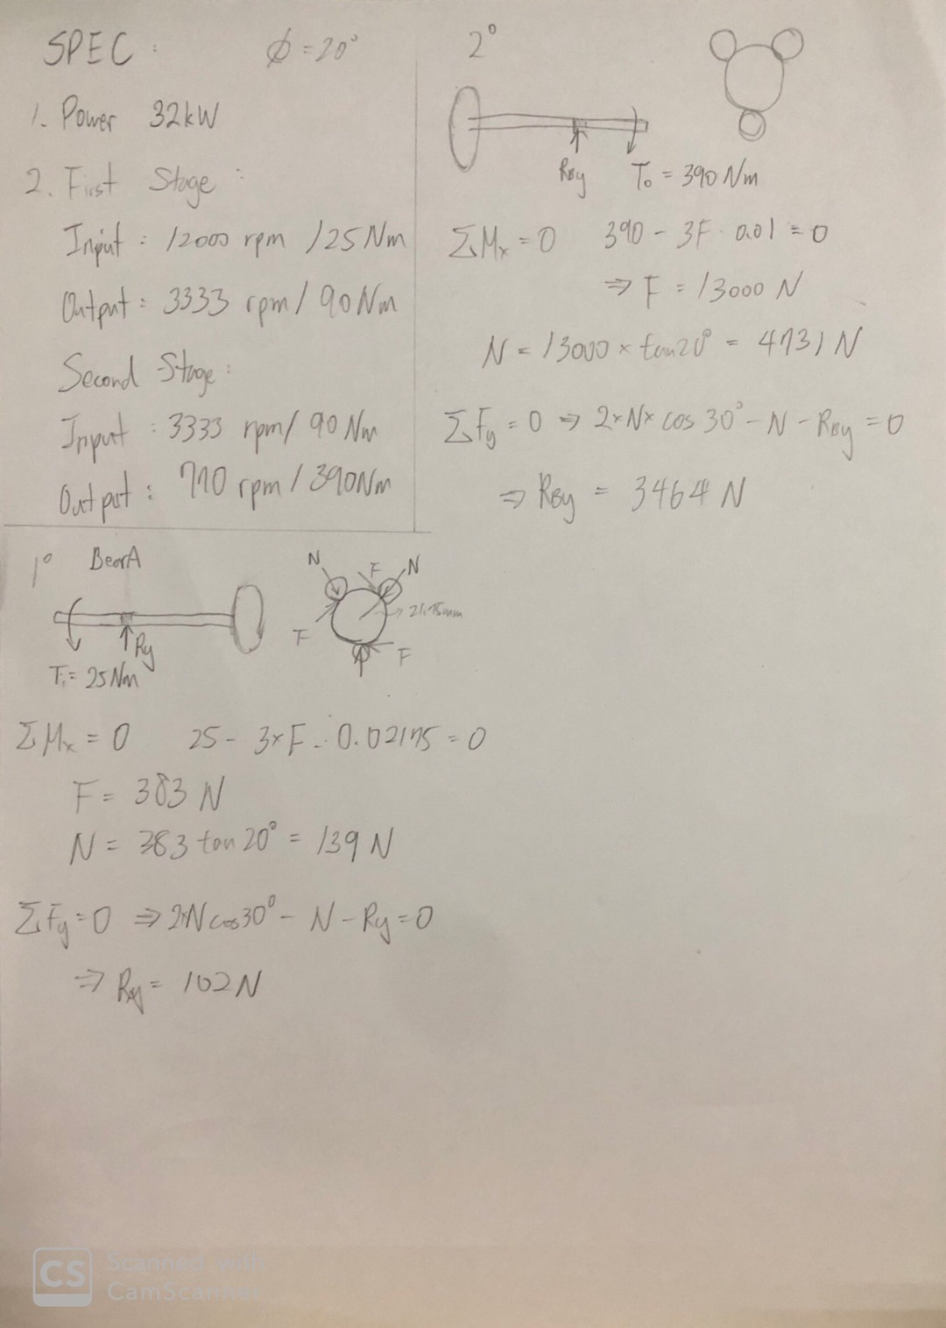
Shaft - Calculation
Precise

Slide 29
Load Condition - Design Flow

Slide 30
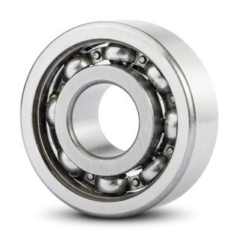
Bearing - What bearing?
Bearing type: deep groove bearing
Why choose it?
1. 安靜
2. 震動小
3. 高轉速

Slide 31
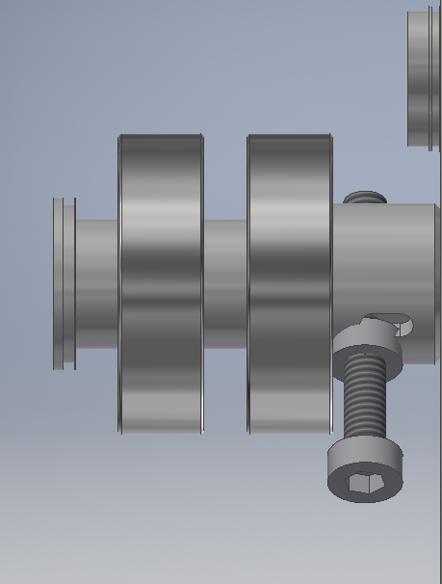
Bearing – How to choose bearing?
Part( a ) 輸入轉軸連接處
1.根據spec : 每200km更換一次 → 訂定車輪尺寸：直徑50cm
2.根據output rpm : 770rpm → 時速約 72.57 km
3.200km / 72.57 = 2.76 hr → Desired life Ld = 3hr
4.Load Condition : FD (Free body diagram)
太陽齒輪
輸入端

Slide 32
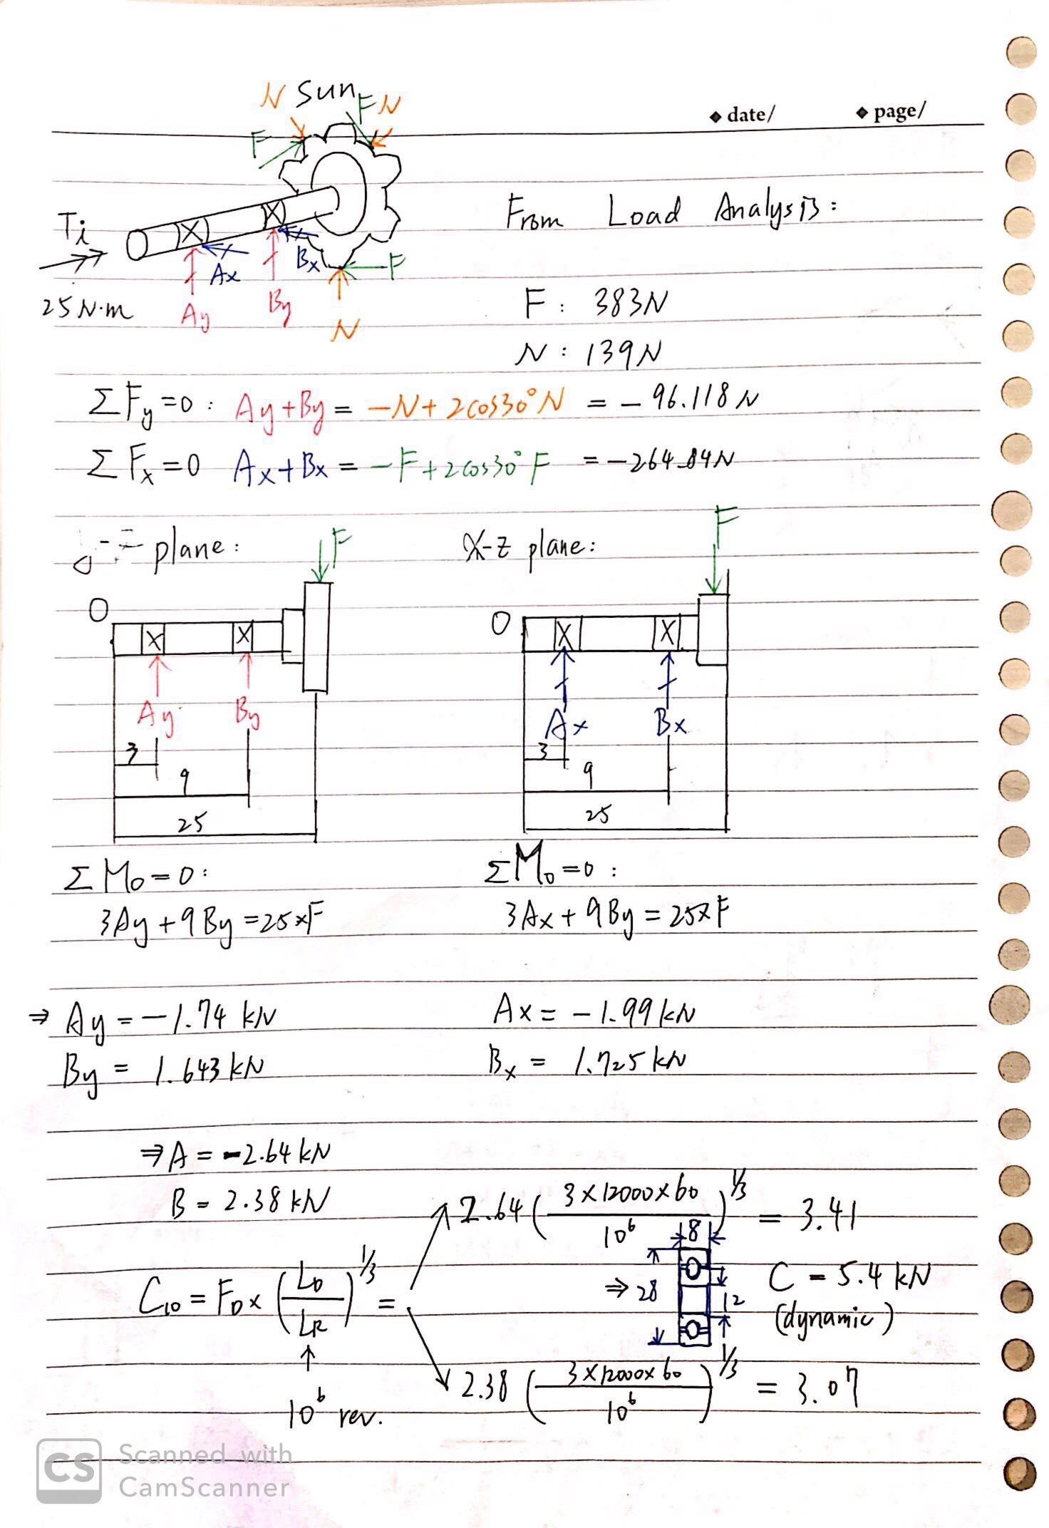
Bearing – Input FBD

Slide 33
Bearing – Input FBD

Slide 34
Bearing – Input FBD

Slide 35
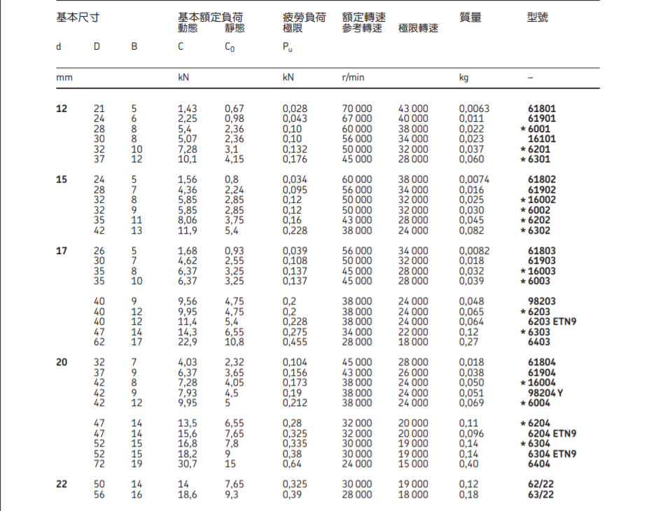
Therefore we choose SKF 6001

Slide 36
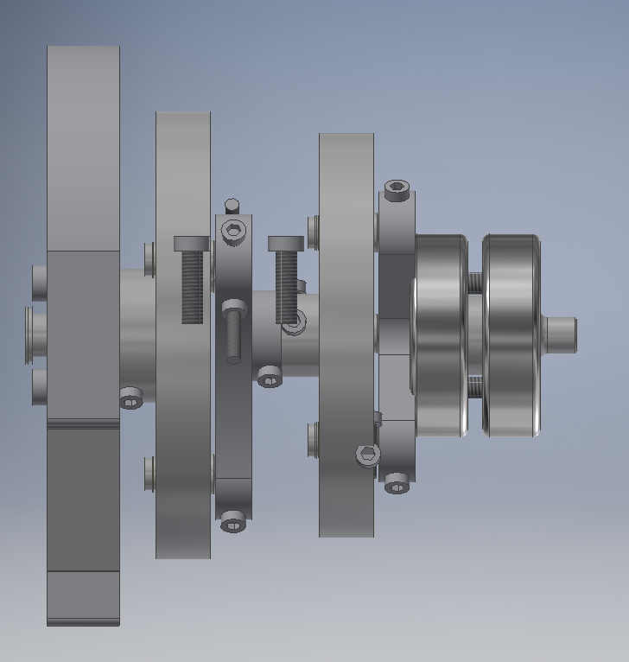
Bearing – How to choose bearing?
Part( b ) 輸出轉軸連接處
1.根據spec : 每200km更換一次 → 訂定車輪尺寸：直徑50cm
2.根據output rpm : 770rpm → 時速約 72.57 km
3.200km / 72.57 = 2.76 hr → Desired life Ld = 3hr
4.Load Condition : FD (Free body diagram)
輸出端
carrier

Slide 37
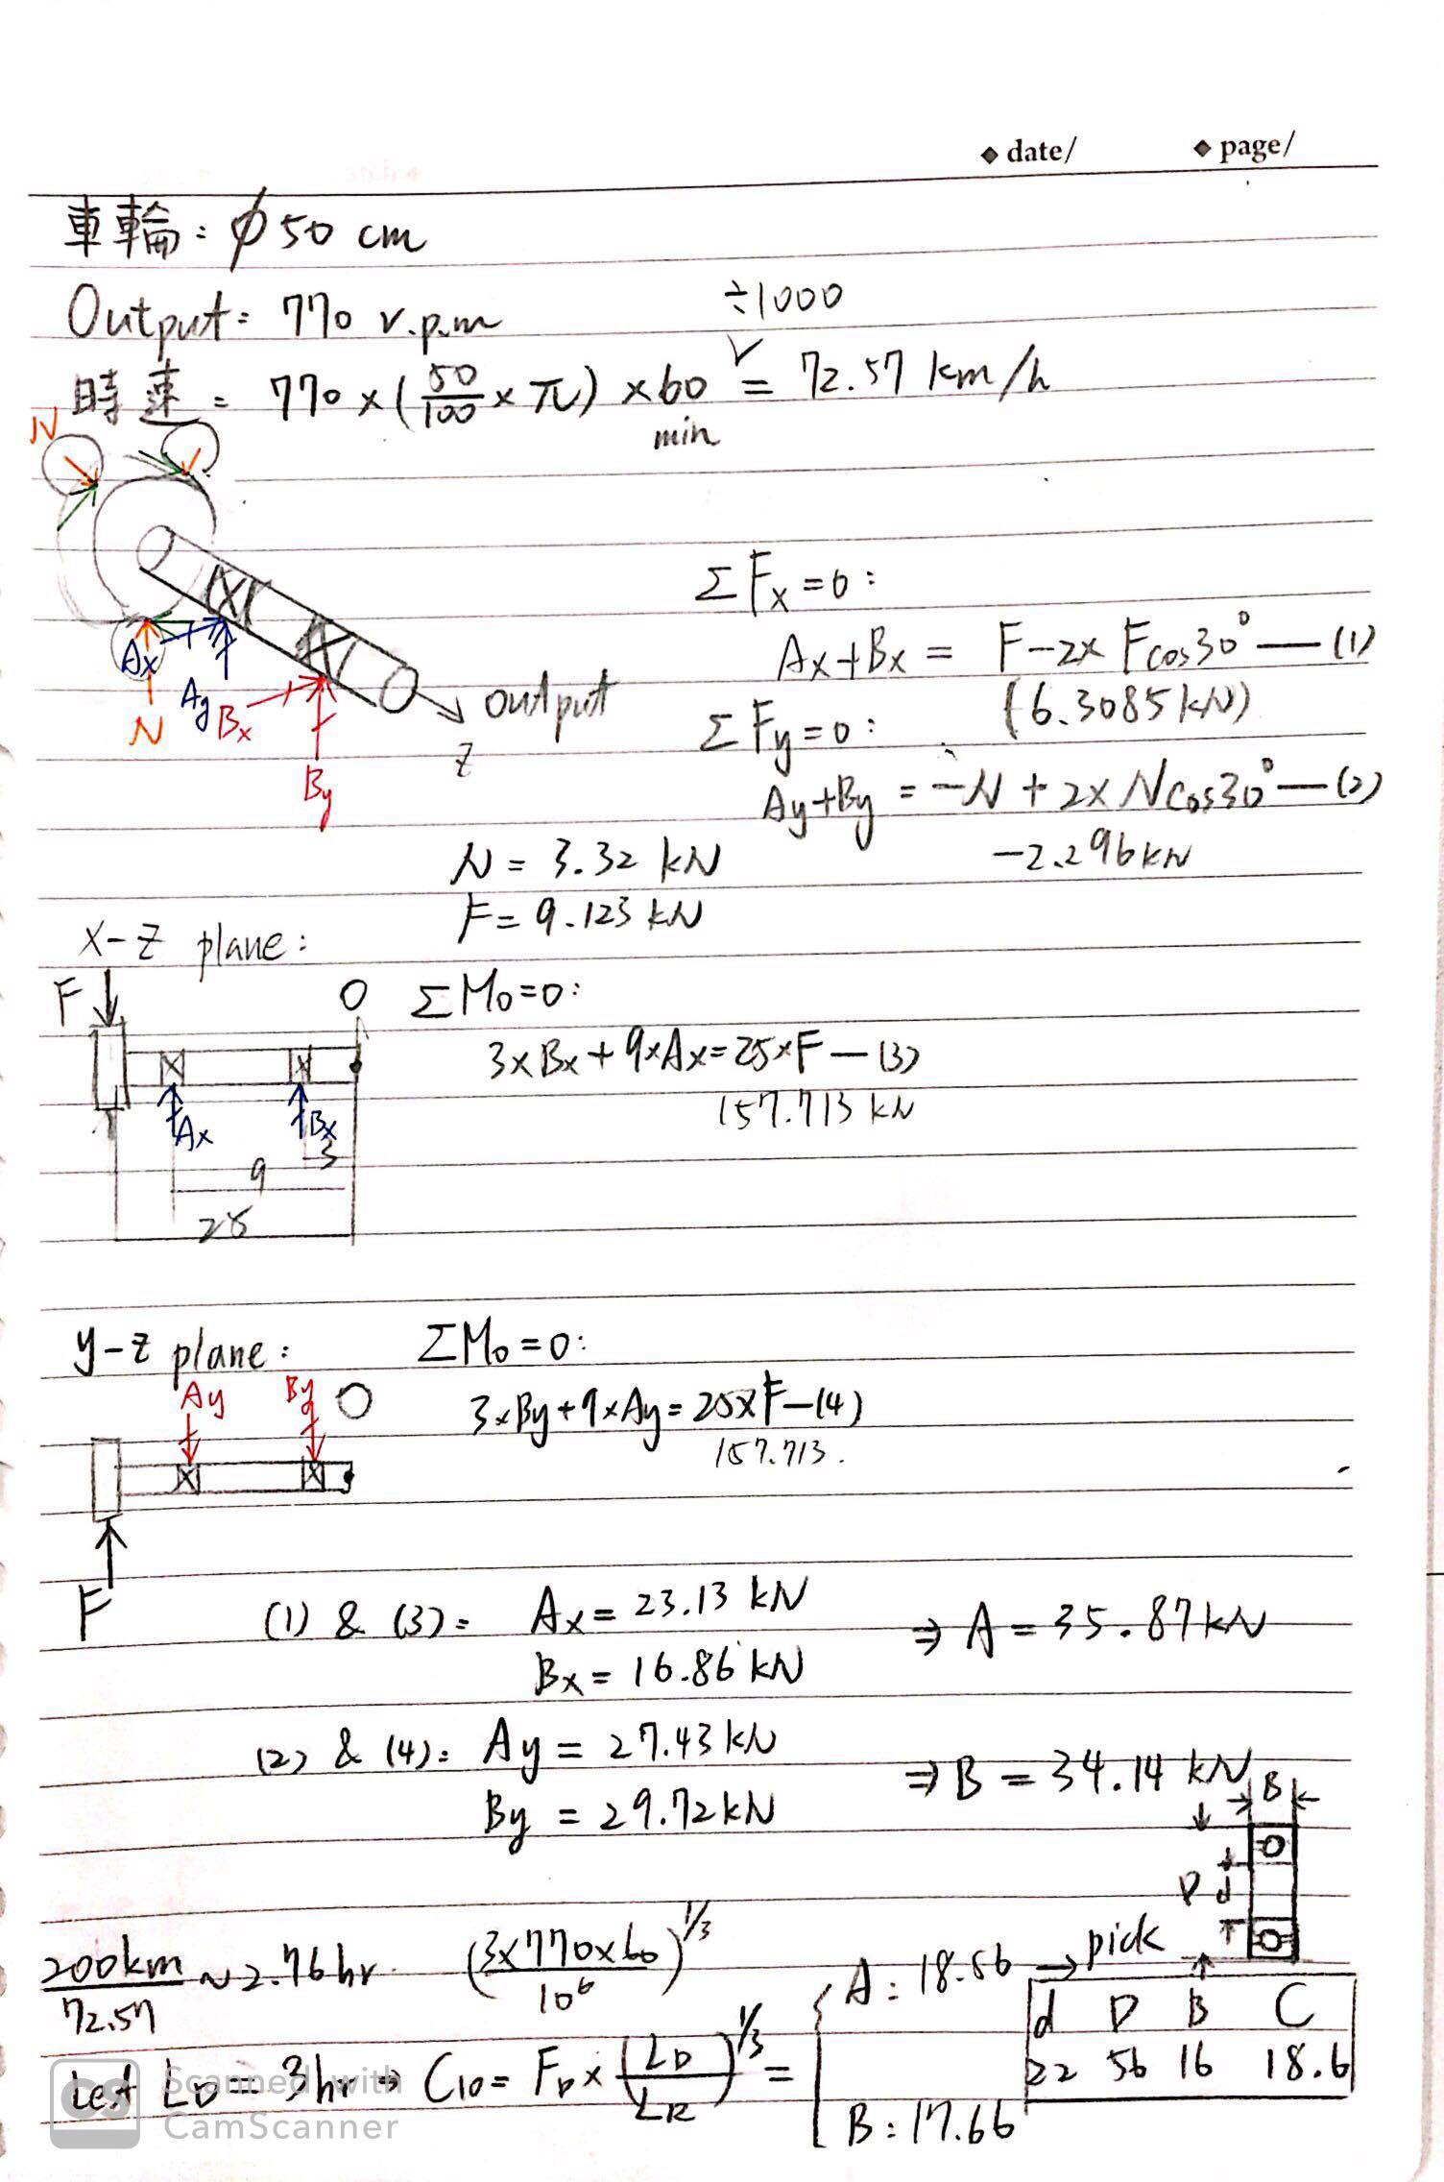
Bearing – Output FBD

Slide 38
Bearing – Output FBD

Slide 39
Bearing – Output FBD

Slide 40
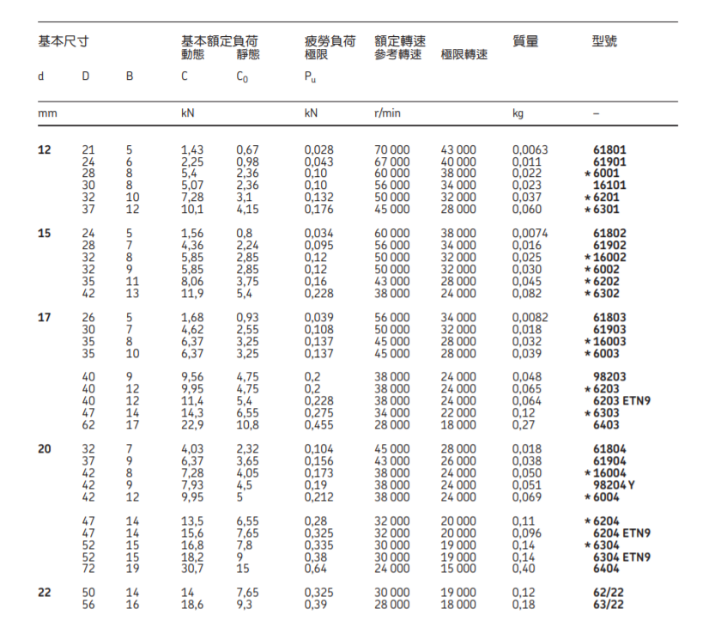
Therefore we choose SKF 63/22

Slide 41
Load Condition - Design Flow

Slide 42

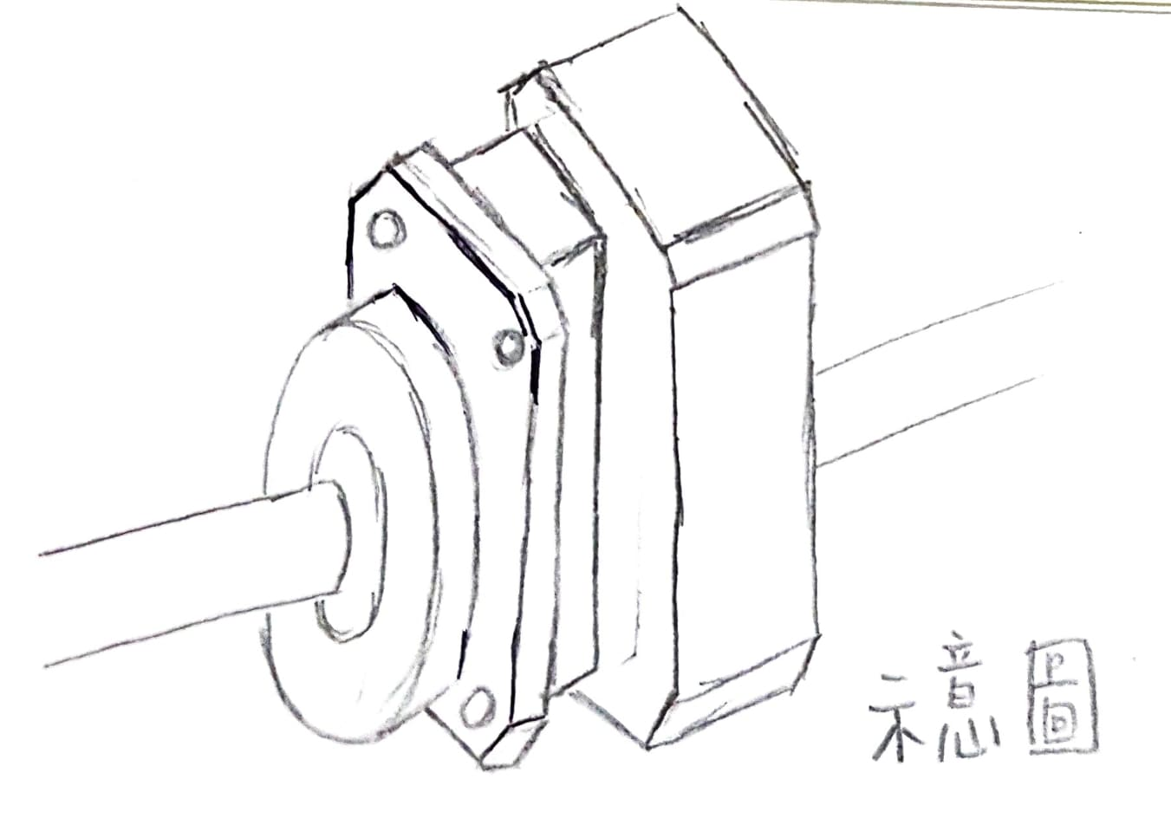
Gear housing

Slide 43
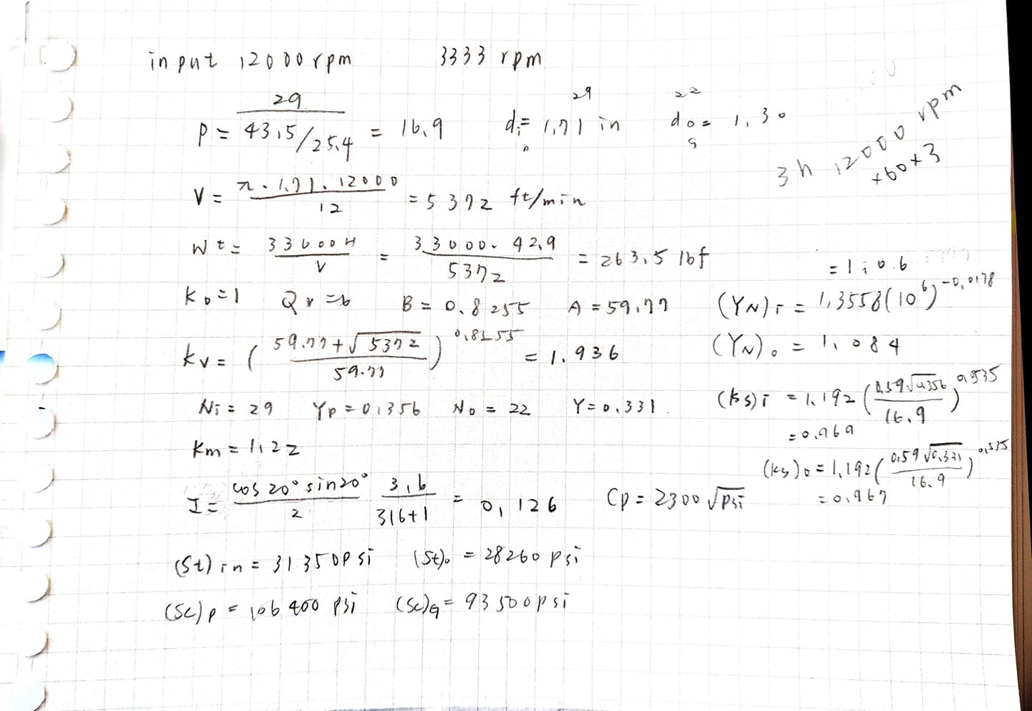
Gears – module、 fatigue loading、 safety factor

Slide 44
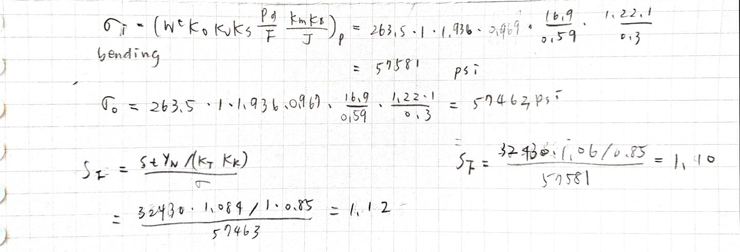
Gears – module、 fatigue loading、 safety factor

Slide 45
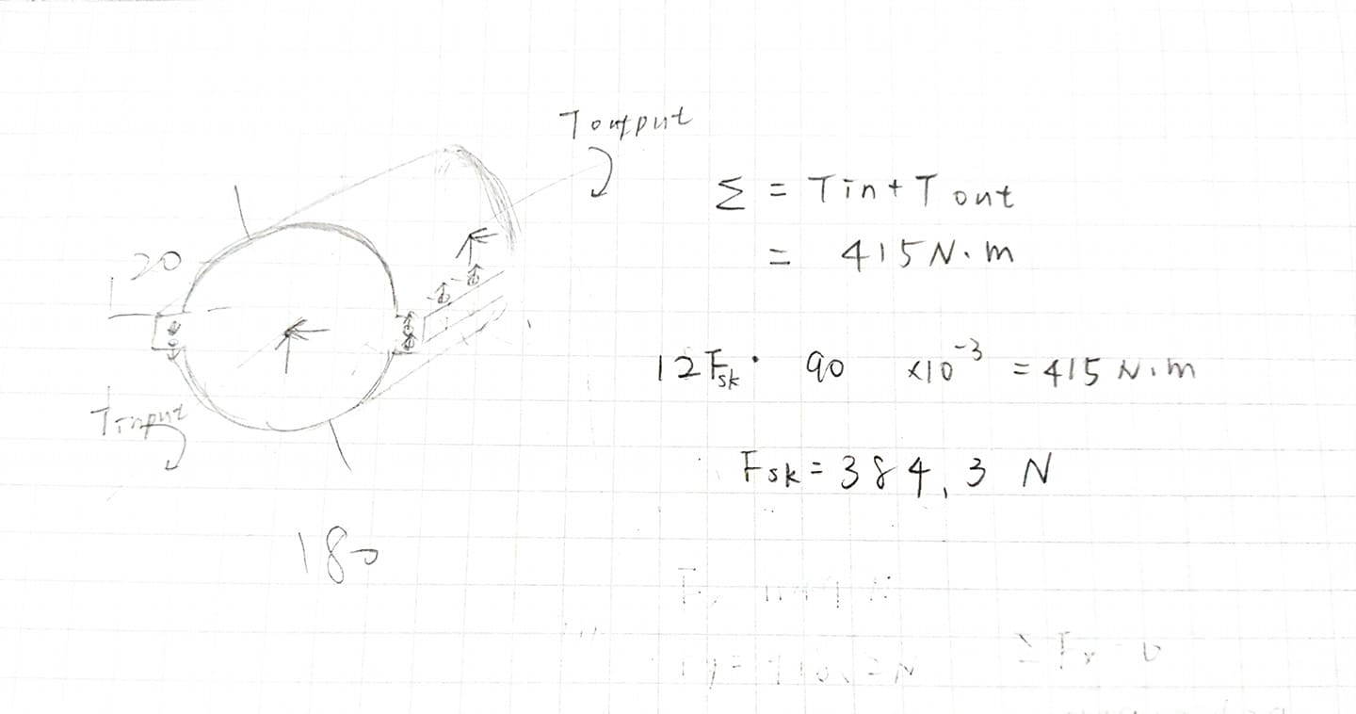
Gear house

Slide 46
Load Condition - Design Flow

Slide 47
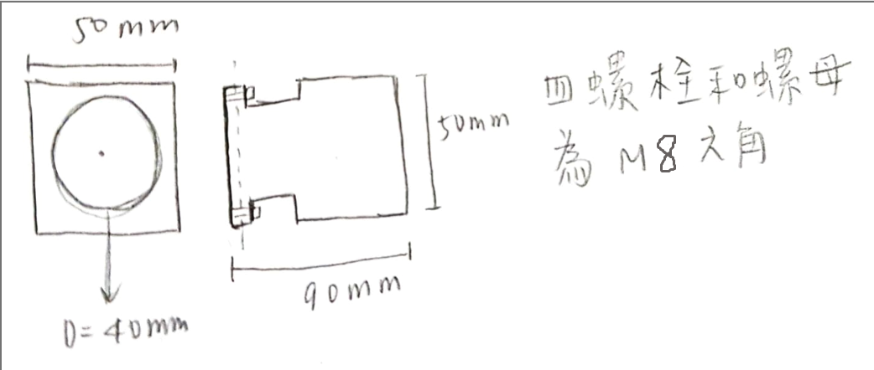
Fasteners (for gear housing )

Slide 48
Outline
Conceptual Design
Load Condition
Engineering Drawing
Presentation

Slide 49
Engineering Drawing
Planetary Gear assembly
Shaft
Key
Bearing
Screws
Gear house

Slide 50
Planetary Gear – First stage
Sun gear
Planet gear
Ring gear
Carrier

Slide 51
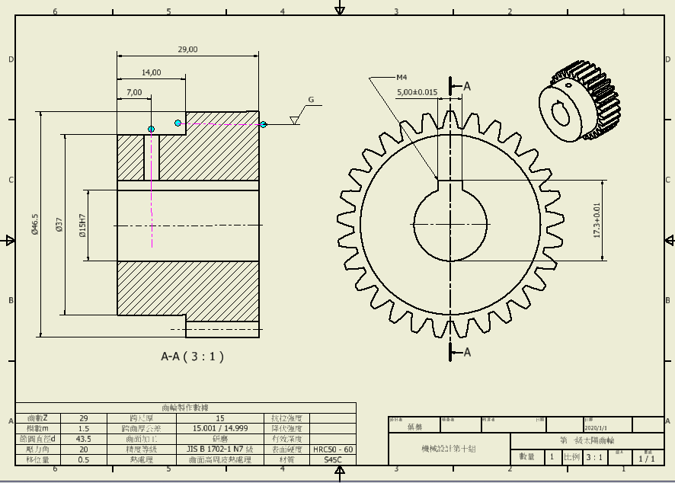
First stage – Sun gear

Slide 52
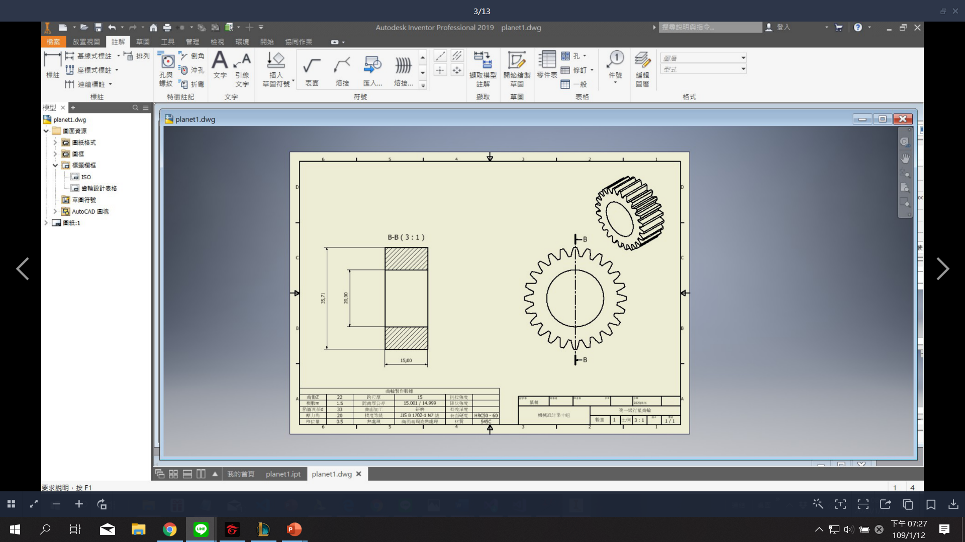
First stage – Planet Gear

Slide 53
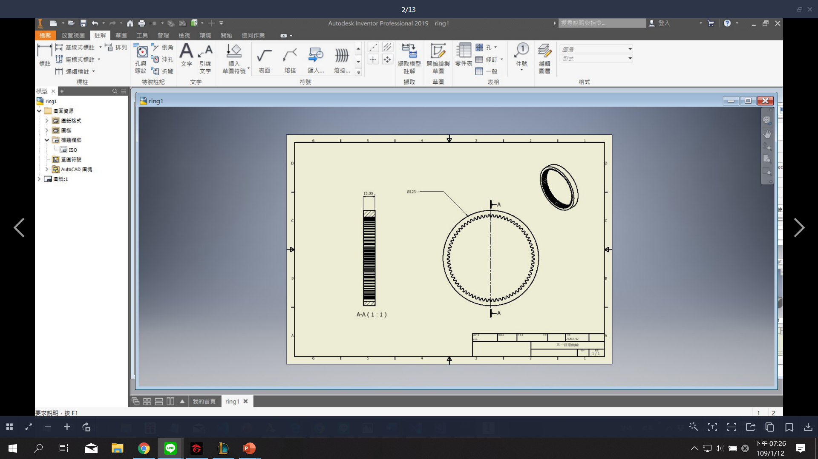
First stage – Ring Gear

Slide 54
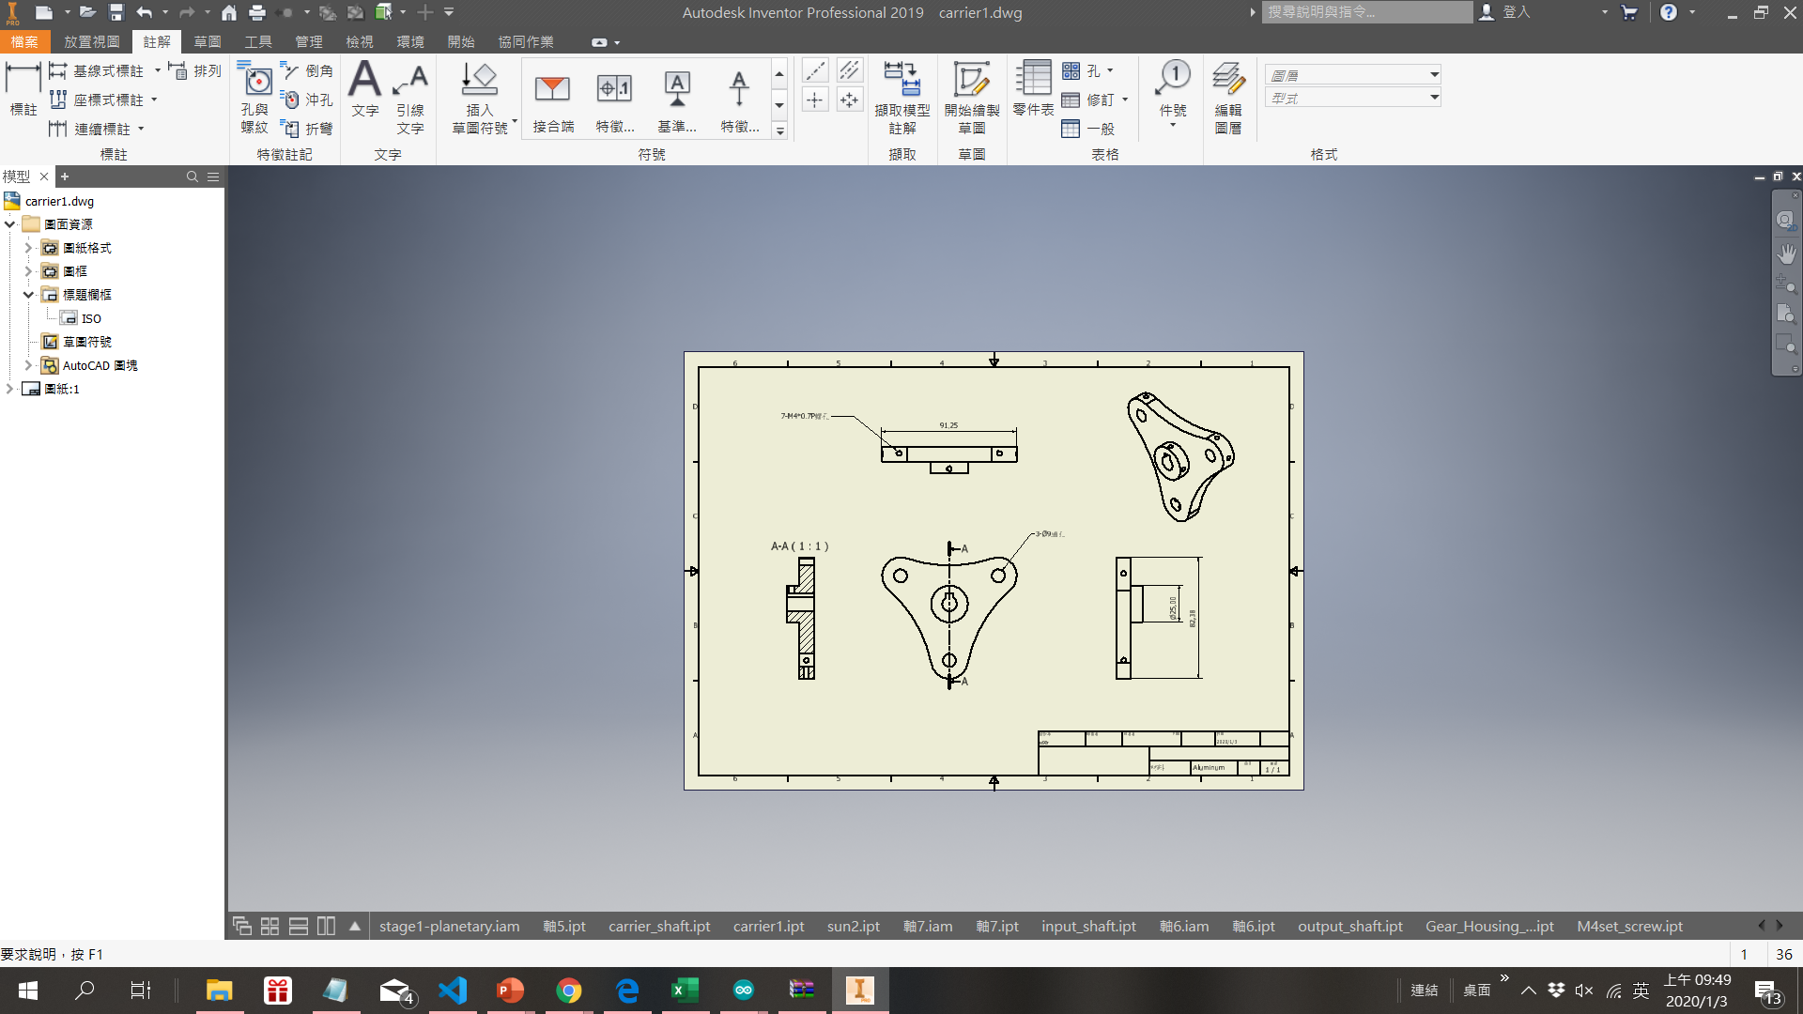
First stage – Carrier

Slide 55
Planetary Gear – Second stage
Sun gear
Planet gear
Ring gear
Carrier

Slide 56
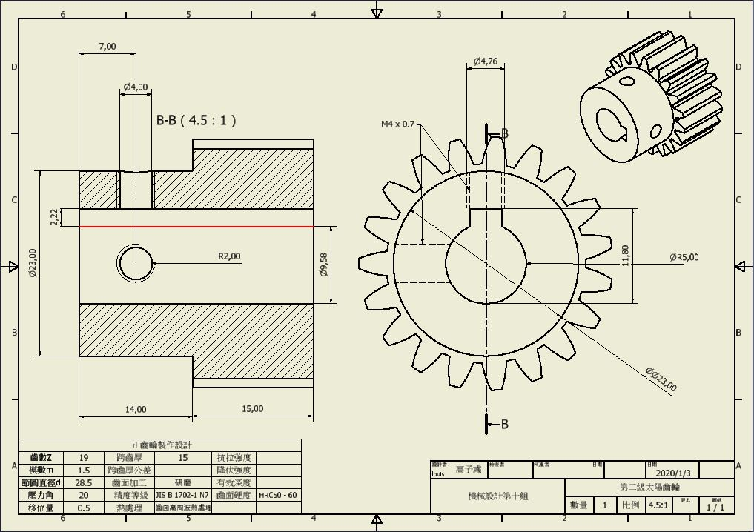
Second stage – Sun Gear

Slide 57
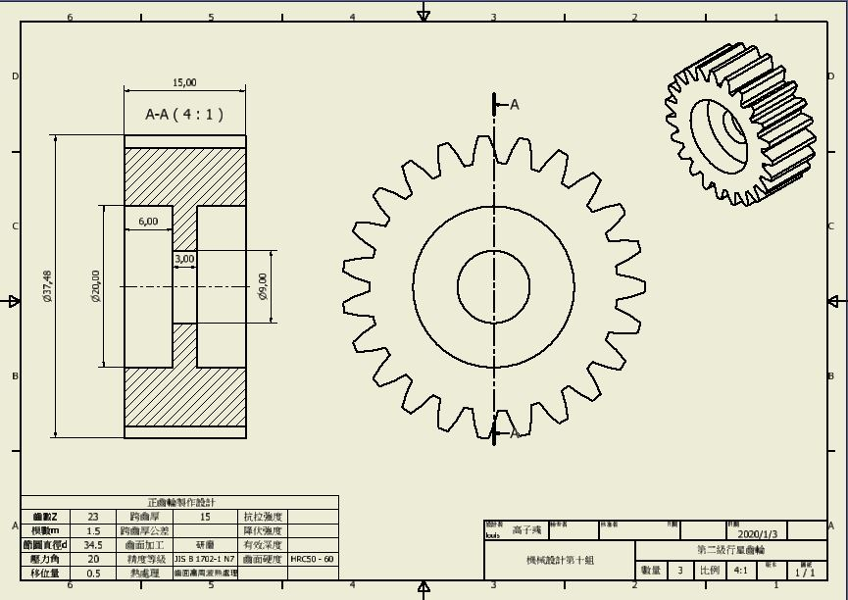
Second stage – Planet Gear

Slide 58
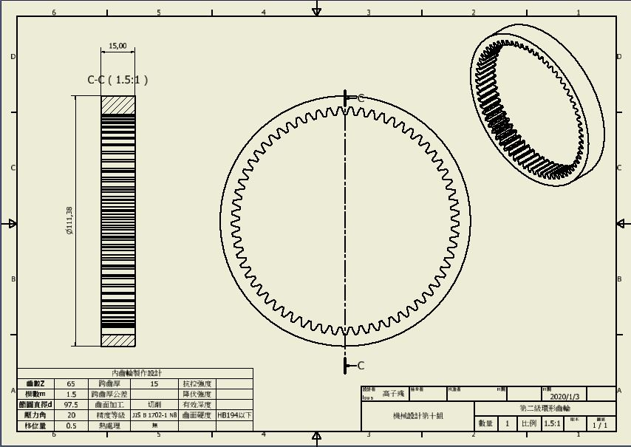
Second stage – Ring Gear

Slide 59
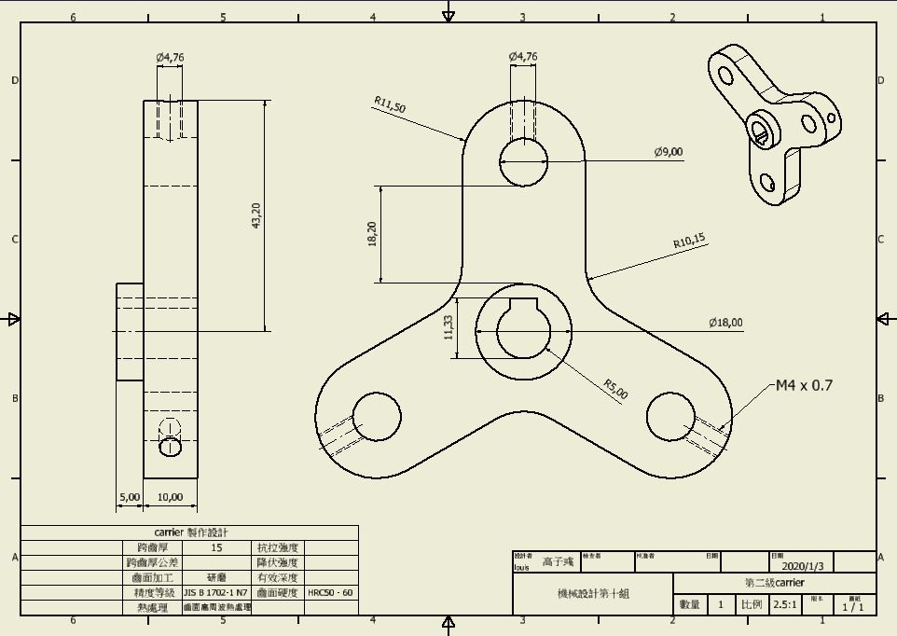
Second stage – Carrier

Slide 60
Shaft
Input Shaft
Middle Shaft
Output Shaft
Carrier shaft

Slide 61
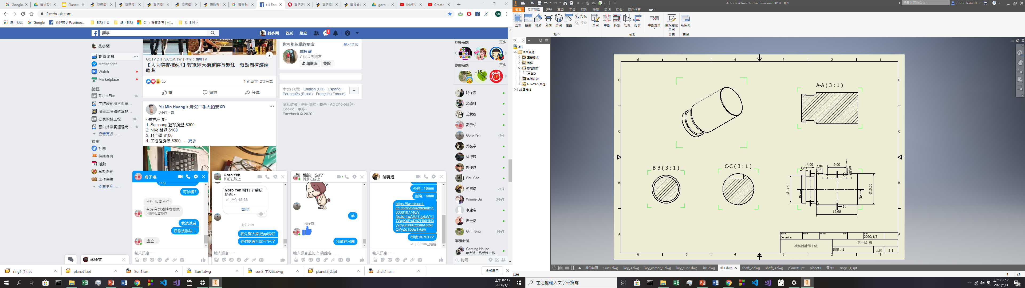
Shaft : Input Shaft

Slide 62
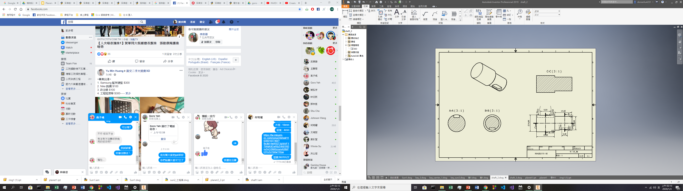
Shaft : Middle Stage

Slide 63
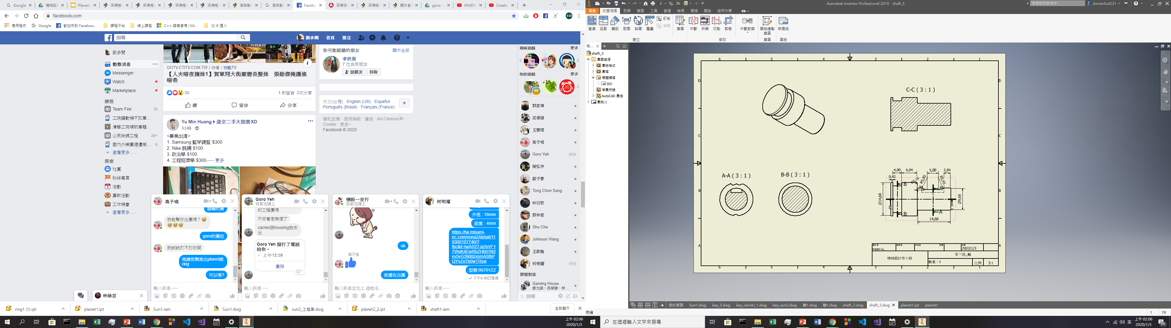
Shaft : Output shaft

Slide 64
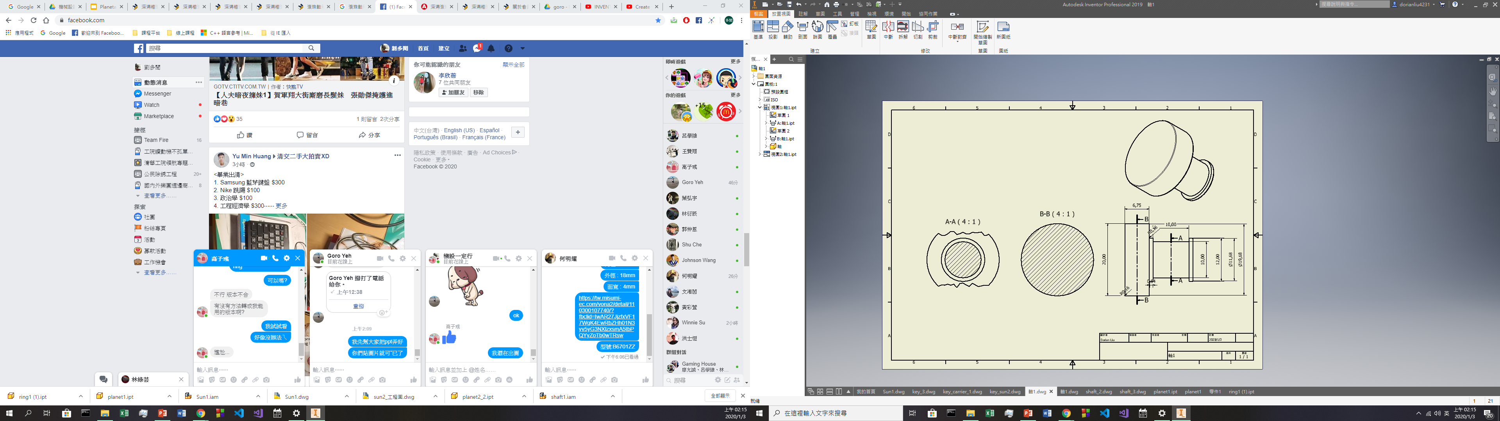
Shaft : Carrier Shaft

Slide 65
Key
Input Shaft Key
Middle Shaft Key
Output Shaft Key

Slide 66
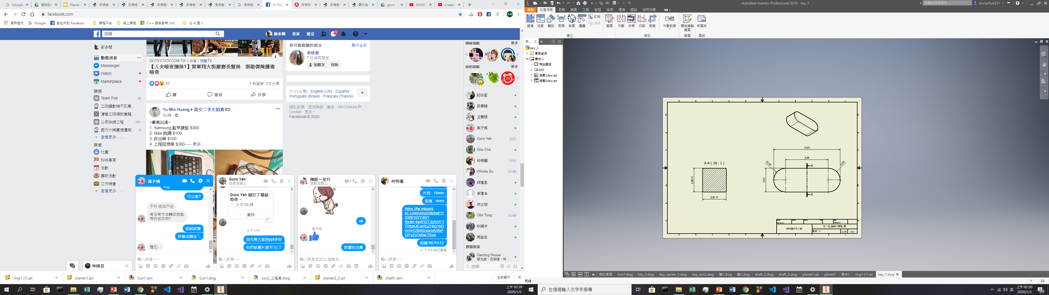
KEY : Input Shaft Key

Slide 67
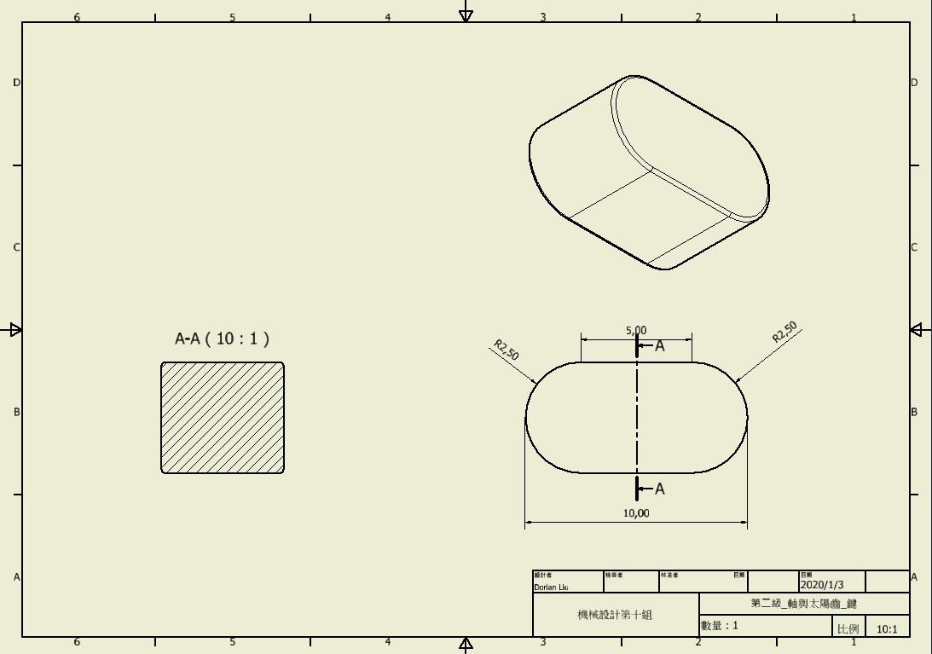
KEY : Middle Shaft Key

Slide 68
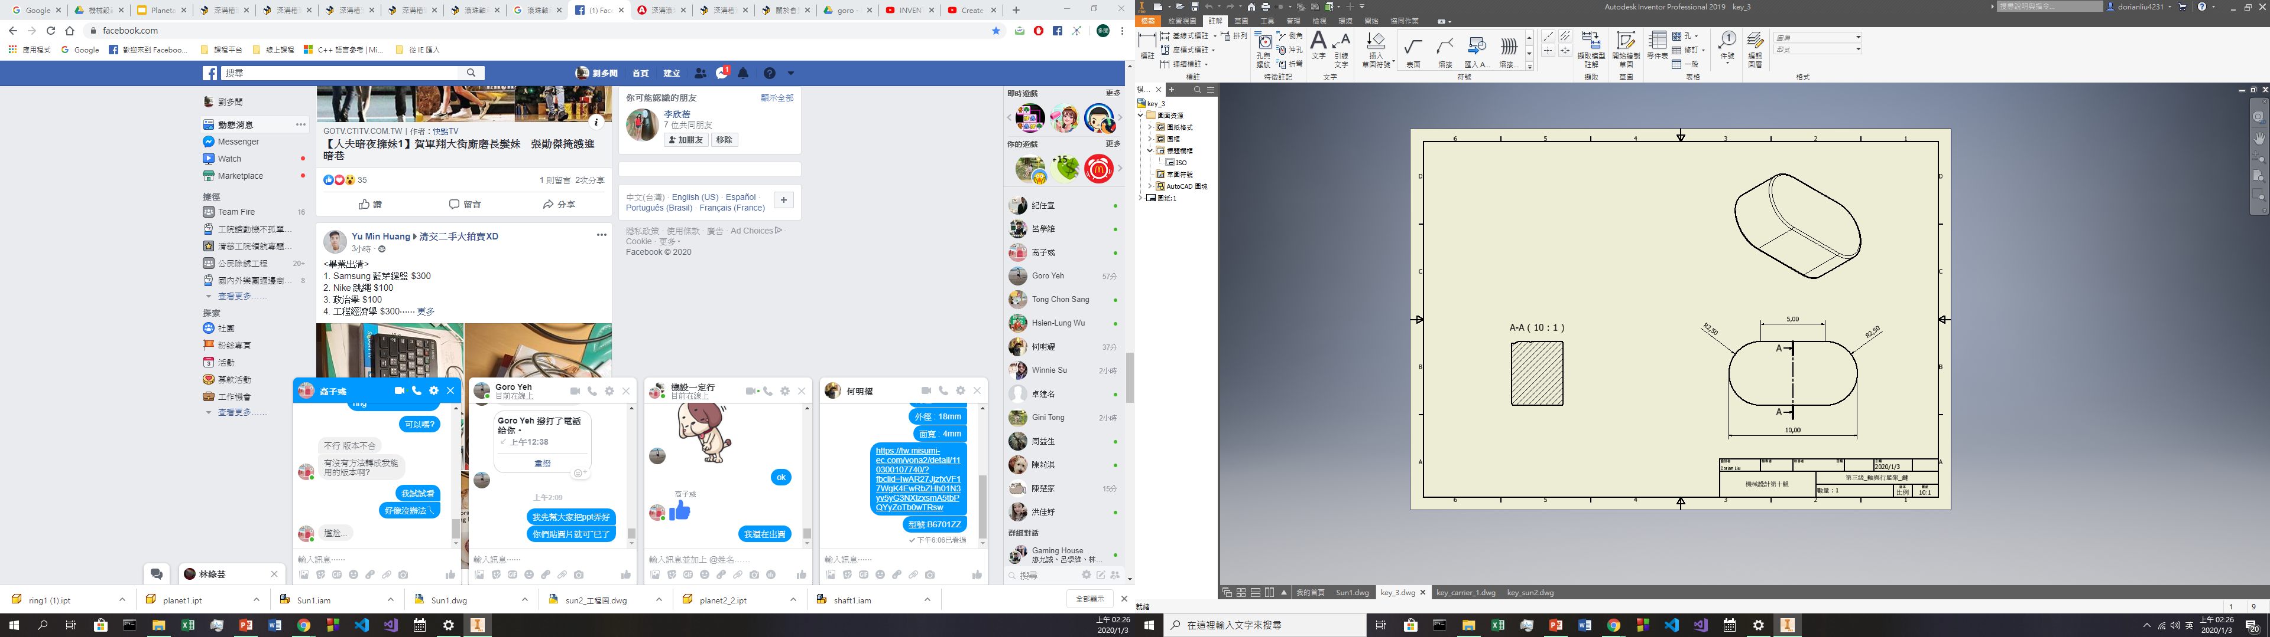
KEY : Output Shaft Key

Slide 69
Bearing
Input bearing
Output bearing
Planet gear bearing

Slide 70
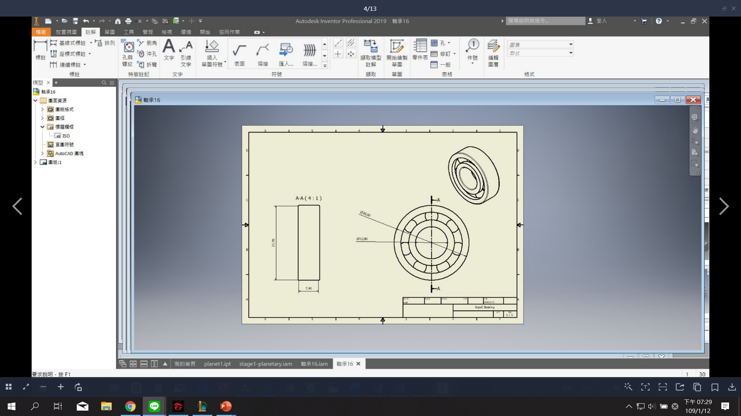
Input Bearing

Slide 71
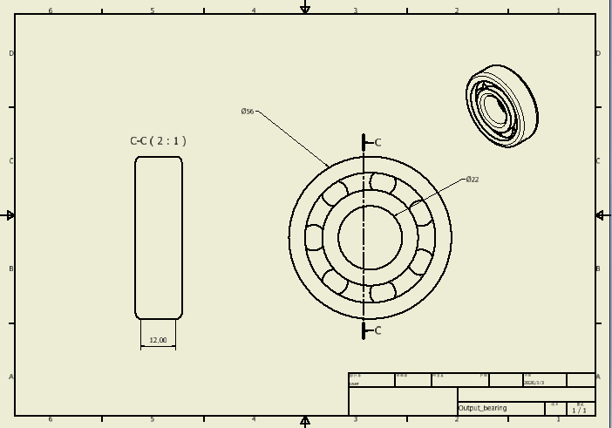
Output Bearing

Slide 72
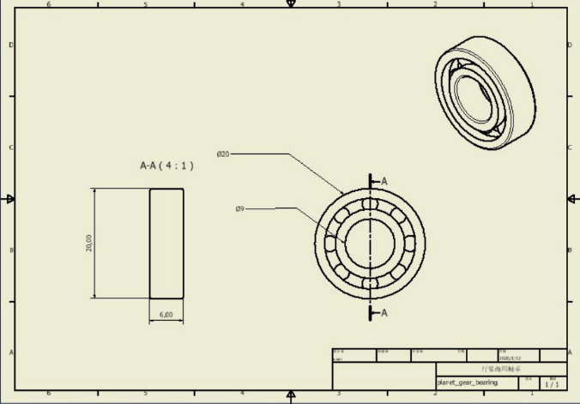
Planet Gear Bearing

Slide 73
Screws
M4 * 0.7P screws
M6 * 1.0P screws

Slide 74
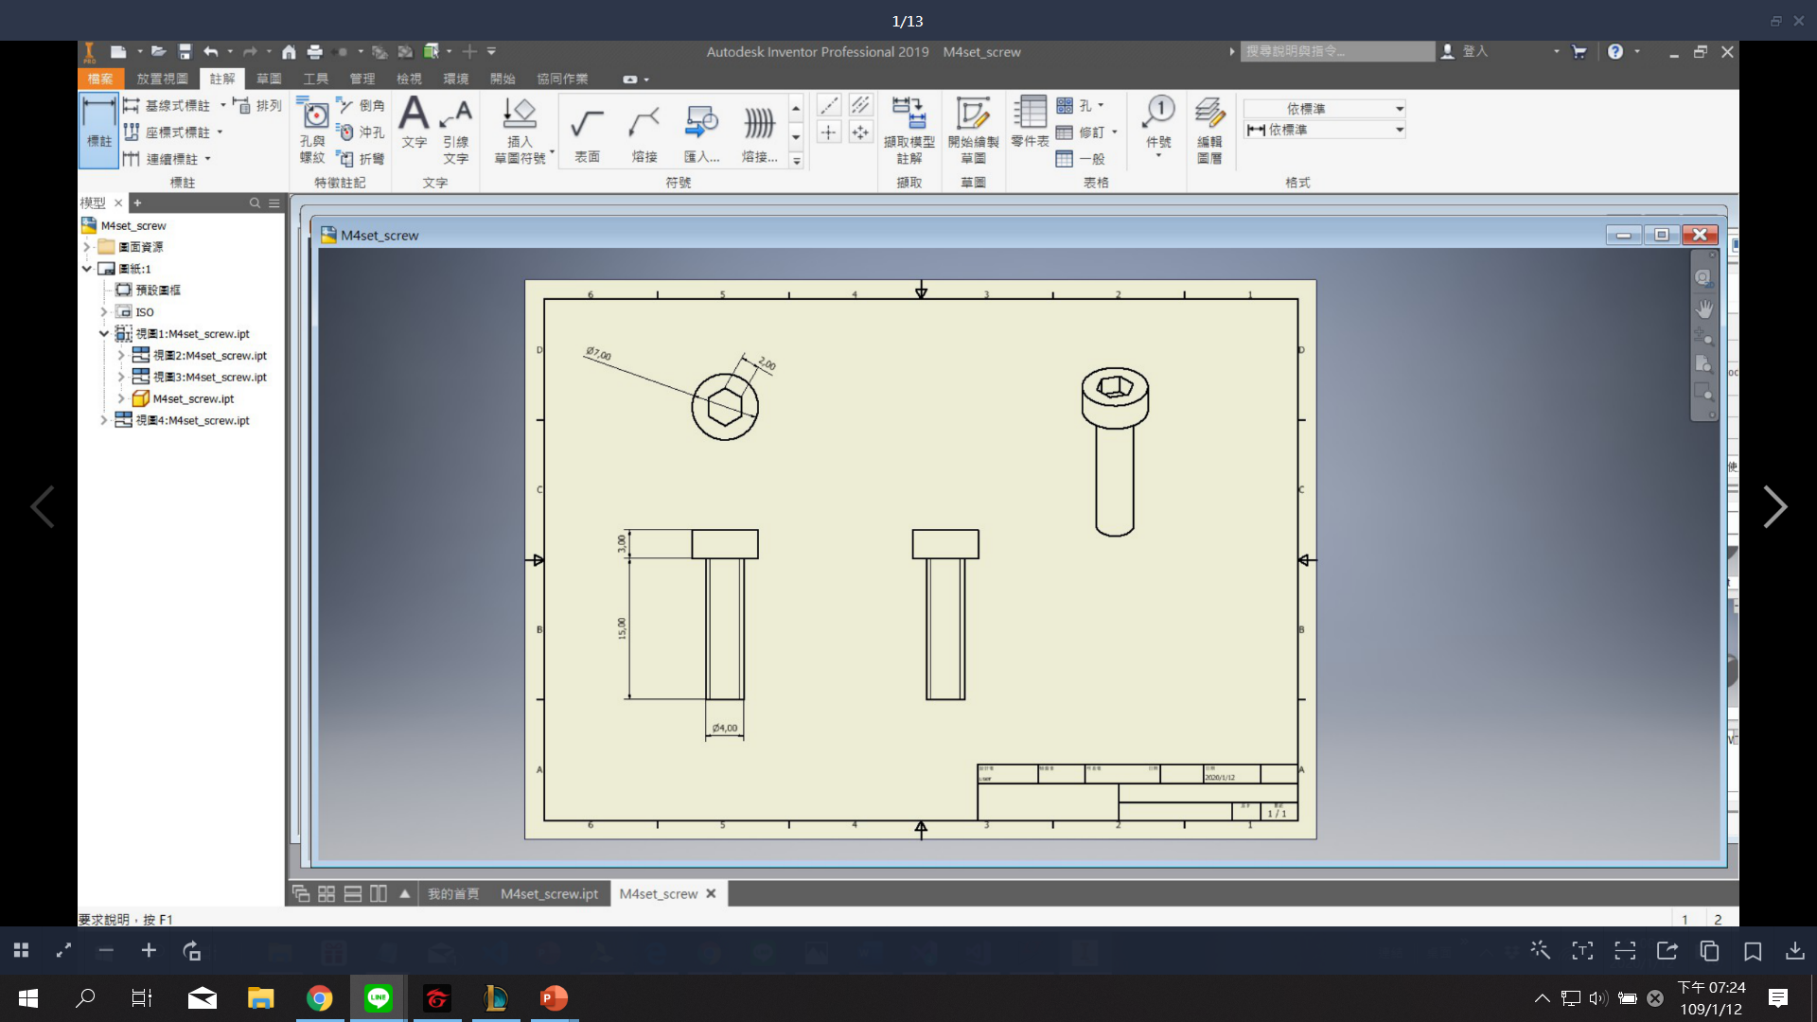
M4 * 0.7P screws

Slide 75
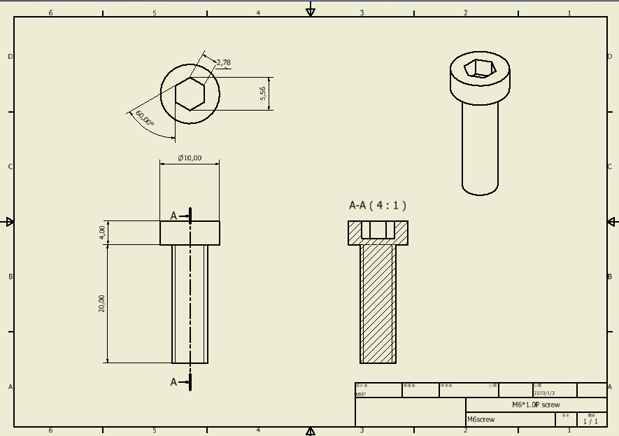
M6 * 1.0P screws

Slide 76
Gear house
Input lid
Top
Bottom
Output lid

Slide 77
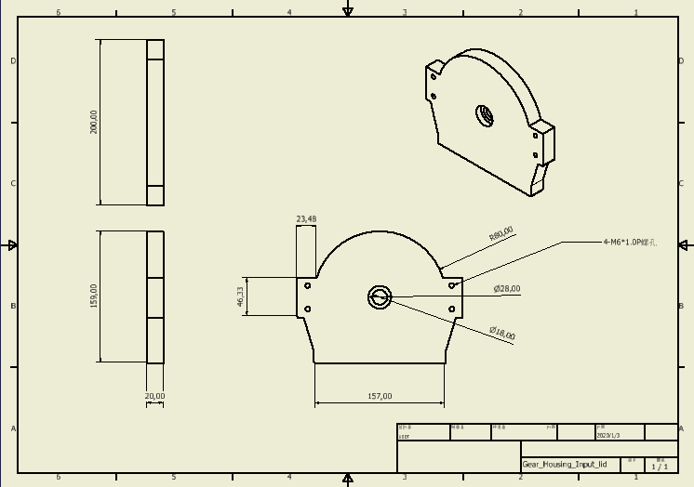
Gear house – Input Lid

Slide 78
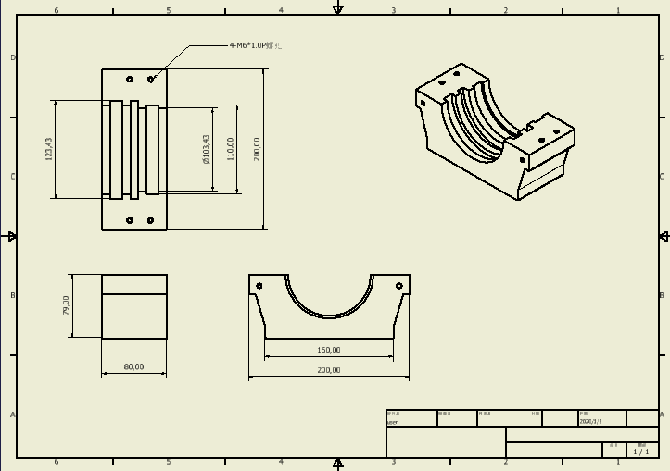
Gear house - Bottom

Slide 79
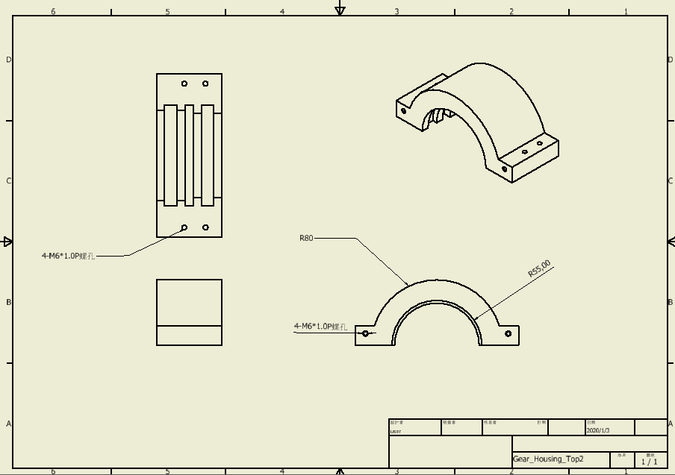
Gear house - Top

Slide 80
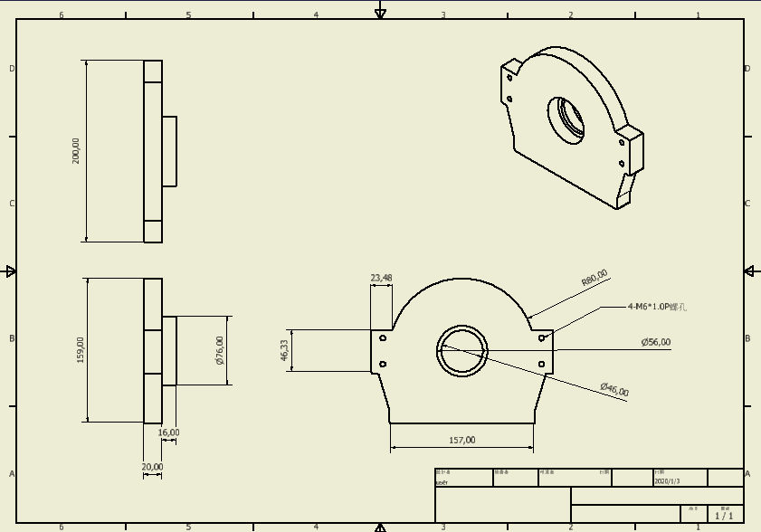
Gear house – Output Lid

Slide 81
Outline
Conceptual Design
Load Condition
Engineering Drawing
Presentation

Slide 82
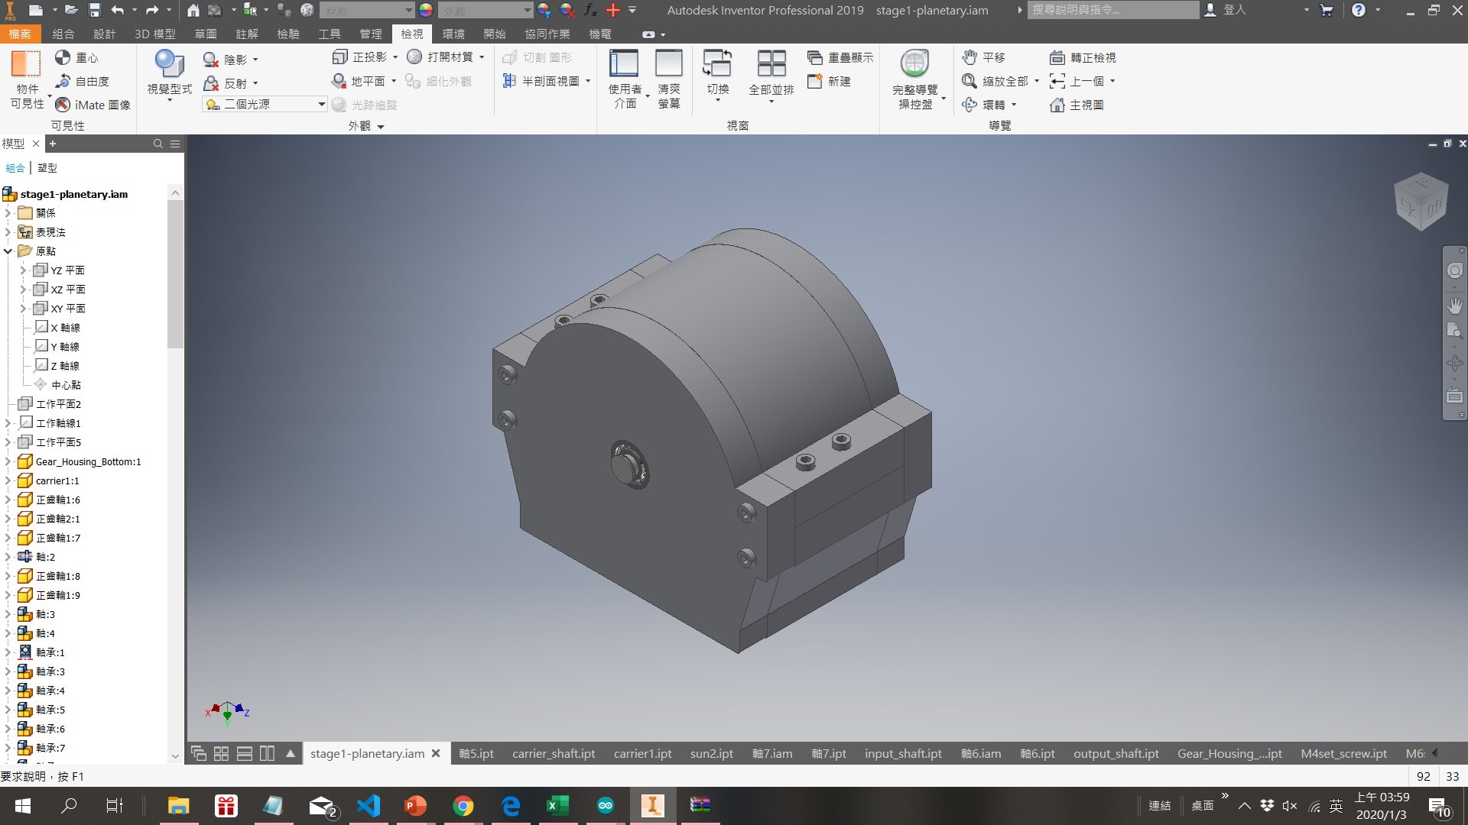
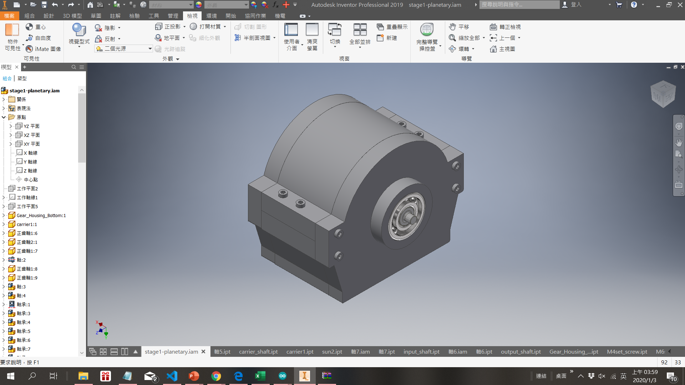
Final Assembly
Output
Input

Slide 83
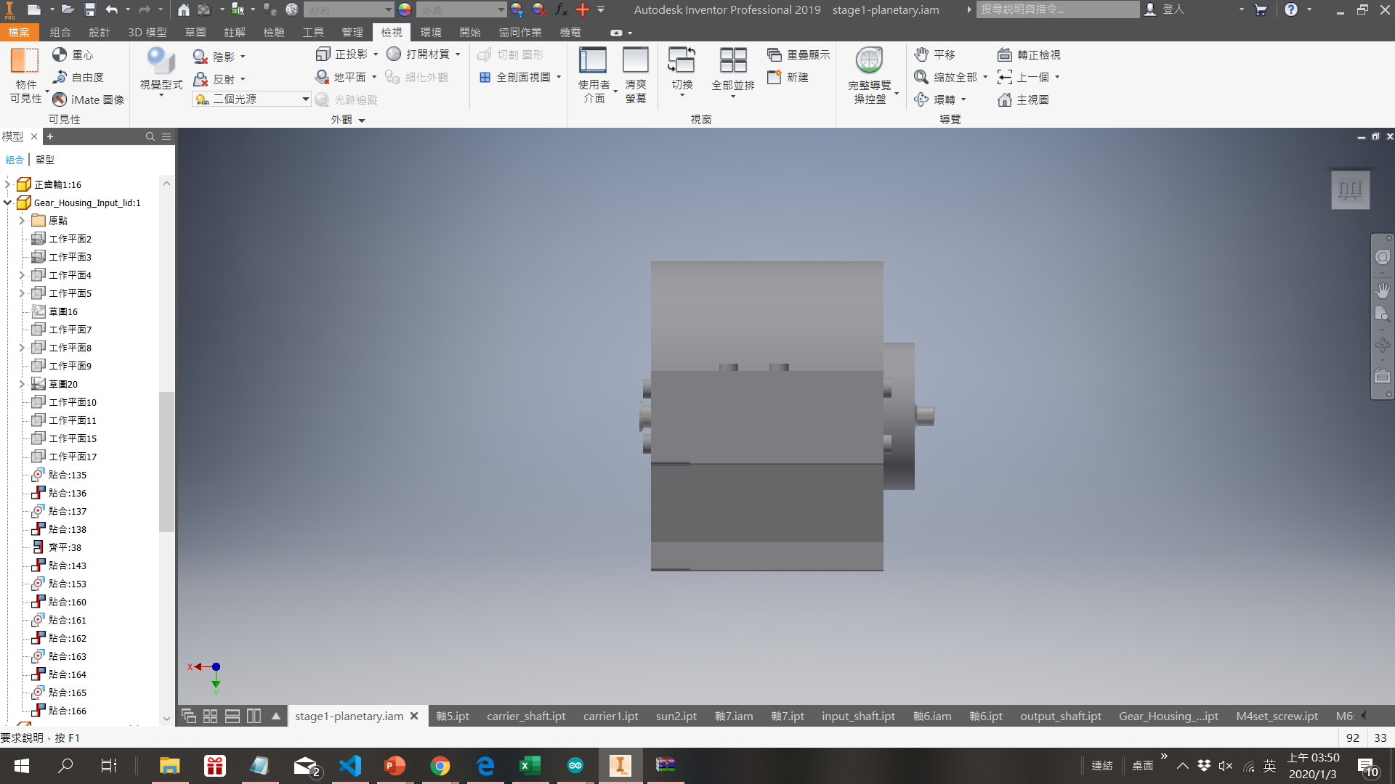

Side view

Slide 84
Side view
First Stage

Slide 85
Side view
First Stage Second Stage

Slide 86

exploded-view drawing

Slide 87

Thank you for listening!

